Slide 1
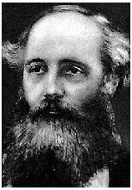
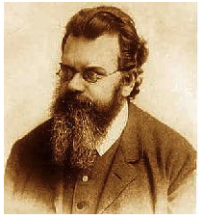
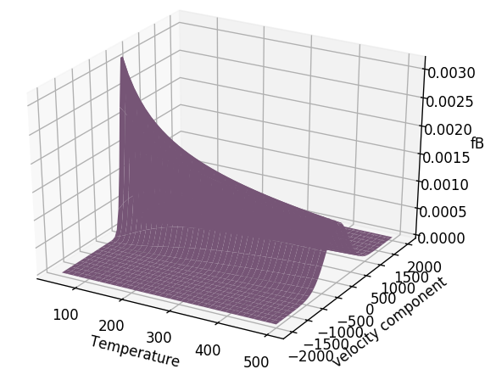
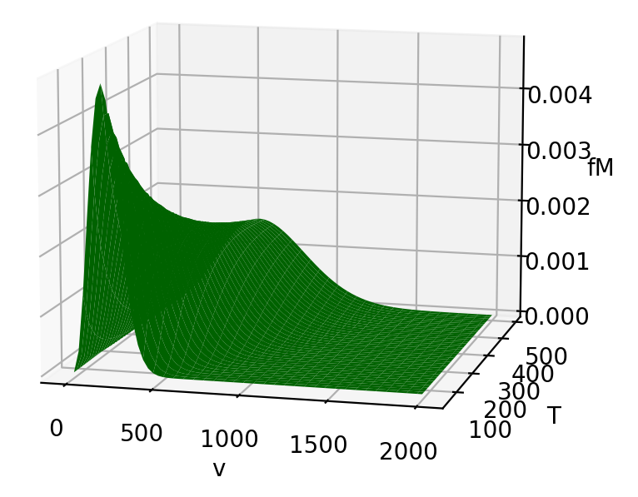
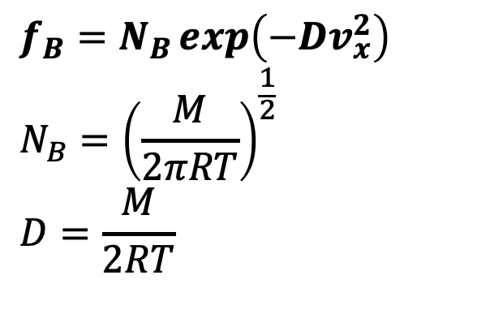
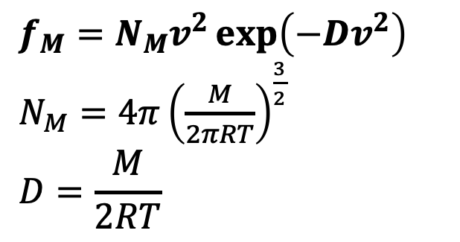
Recap: Boltzmann and Maxwell
$$f_{B}=N_{B}\exp\left(−Dv_{x}^{2}\right)$$
$${N_{B}=\left(\frac{M}{2πRT}\right)}^{\frac{1}{2}}$$
$$D=\frac{M}{2RT}$$
$$f_{M}=N_{M}v^{2}\exp\left(−Dv^{2}\right)$$
$N_{M}=4π{\left(\frac{M}{2πRT}\right)}^{\frac{3}{2}}$
$$D=\frac{M}{2RT}$$

Slide 2

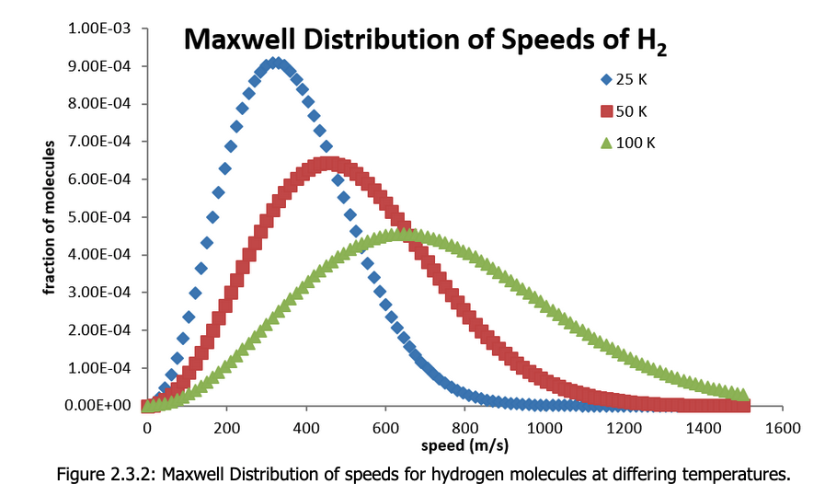


Recap: Normalization
We said that $f_{B}(v_{x})$ and $f_{M}(v)$are normalized =>
isotherms of $f_{M}\left(v\right)$ for $H_{2}(g)$

Slide 3
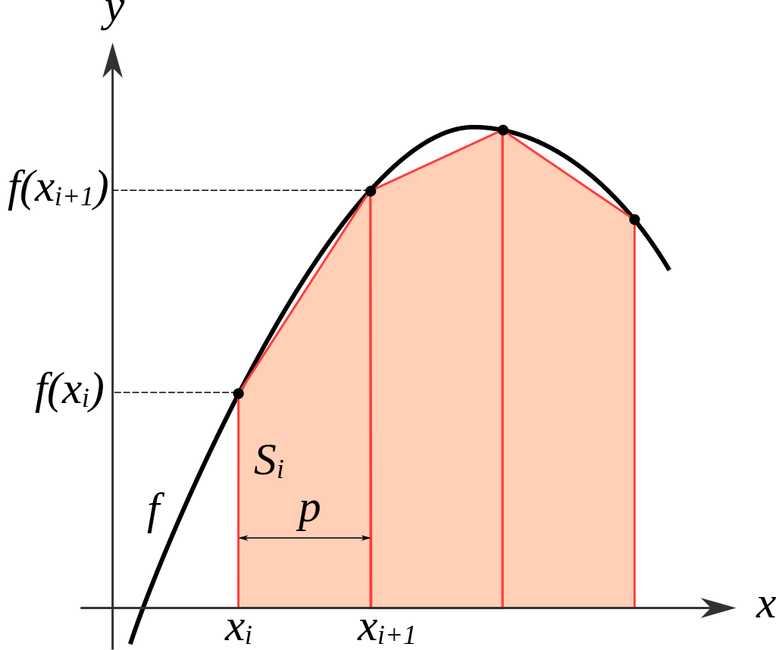
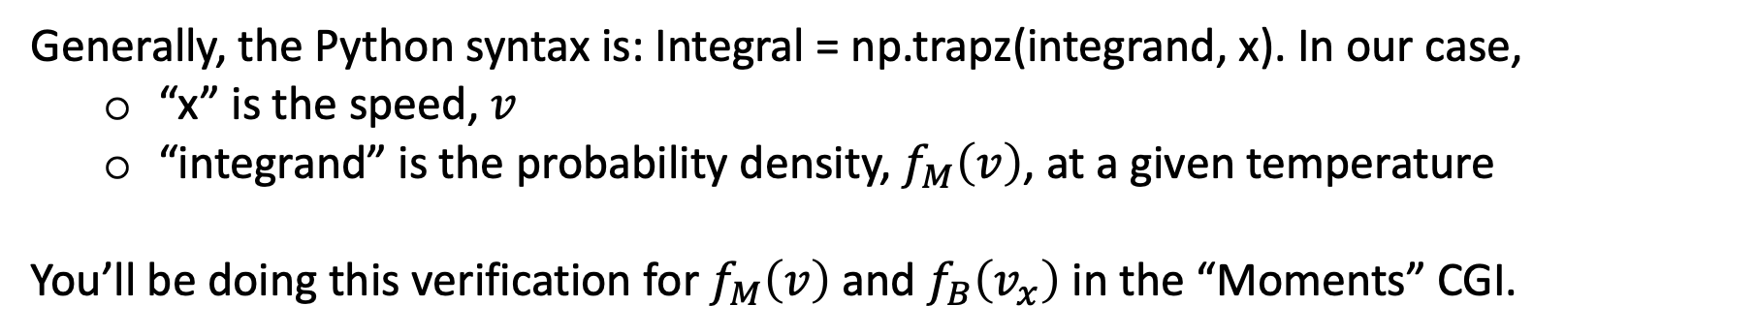
But how do we know those isotherms are normalized? Answer: verify by numerical integration
https://en.wikipedia.org/wiki/Trapezoidal_rule
integrand
integral
Generally, the Python syntax is: Integral = np.trapz(integrand, x). In our case,
“x” is the speed, $v$
“integrand” is the probability density, $f_{M}\left(v\right)$, at a given temperature
You’ll be doing this verification for $f_{M}\left(v\right)$ and $f_{B}\left(v_{x}\right)$ in the “Moments” CGI.

Slide 4
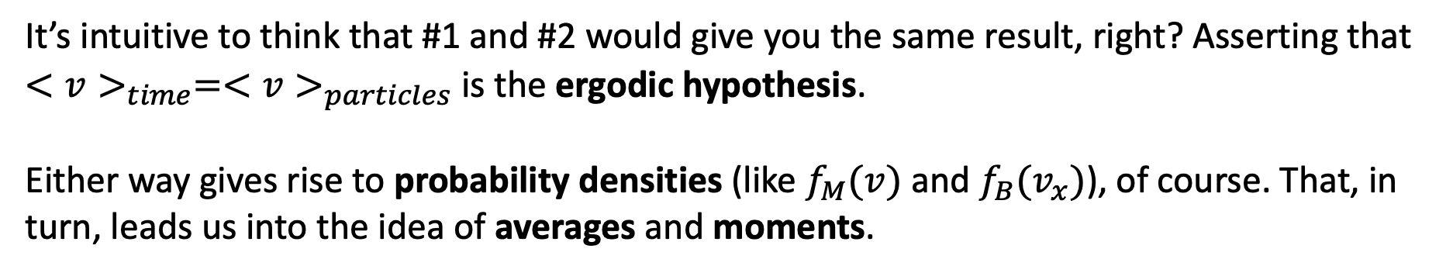
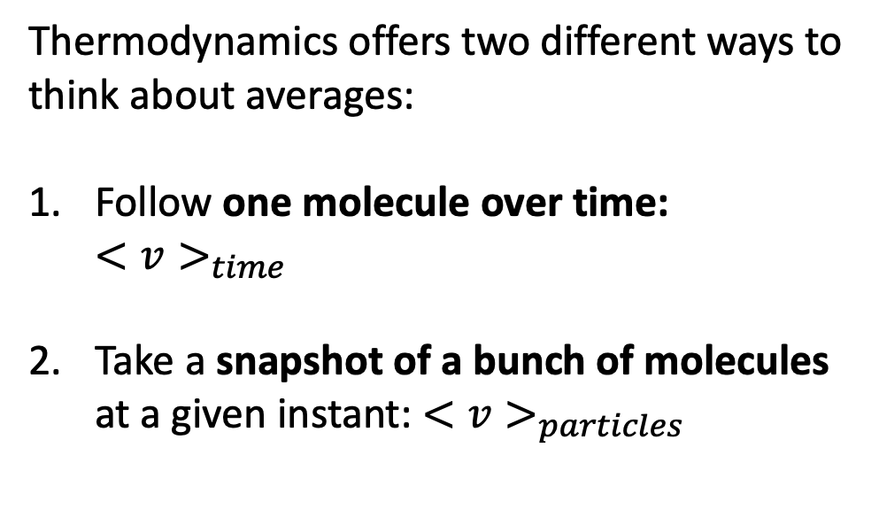
Averages and the Ergodic hypothesis
Thermodynamics offers two different ways to think about averages:
Follow one molecule over time:
$<v>_{time}$
Take a snapshot of a bunch of molecules at a given instant: $<v>_{particles}$
It’s intuitive to think that #1 and #2 would give you the same result, right? Asserting that $<v>_{time}=<v>_{particles}$ is the ergodic hypothesis.
Either way gives rise to probability densities (like $f_{M}(v)$ and $f_{B}(v_{x})$), of course. That, in turn, leads us into the idea of averages and moments.

Slide 5
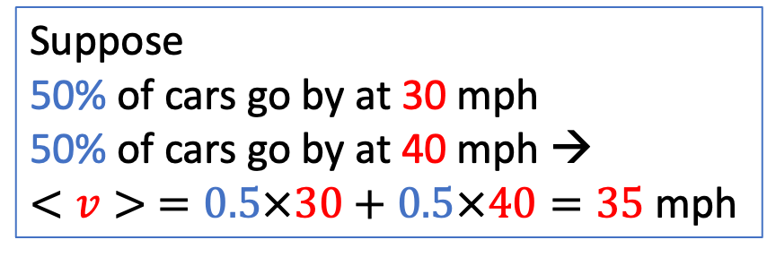
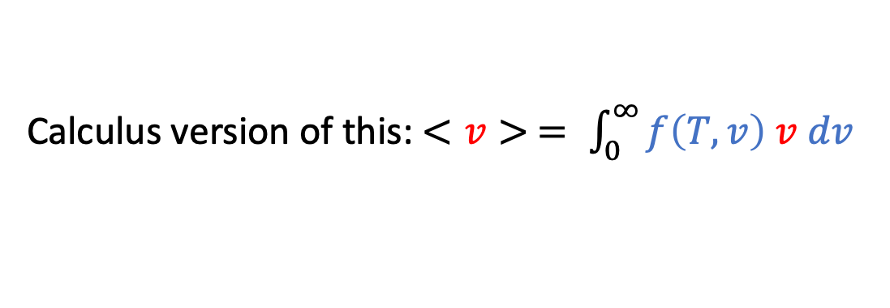
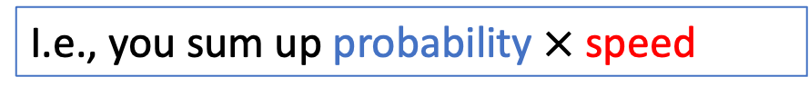
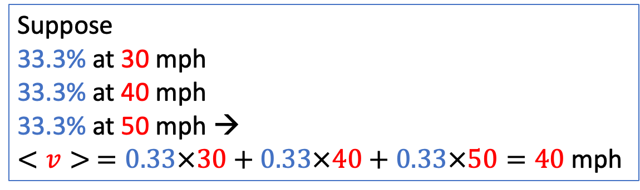
If you wanted to find the average speed of cars on Union Ave …
Suppose
50% of cars go by at 30 mph
50% of cars go by at 40 mph →
$<v> =0.5×30+0.5×40=35$mph
Suppose
33.3% at 30 mph
33.3% at 40 mph
33.3% at 50 mph →
$$<v> =0.33×30+0.33×40+0.33×50=40 \text{mph}$$
I.e., you sum up probability $×$ speed
Calculus version of this: $<v> = \int_{0}^{∞}{f\left(T,v\right) v dv}$

Slide 6
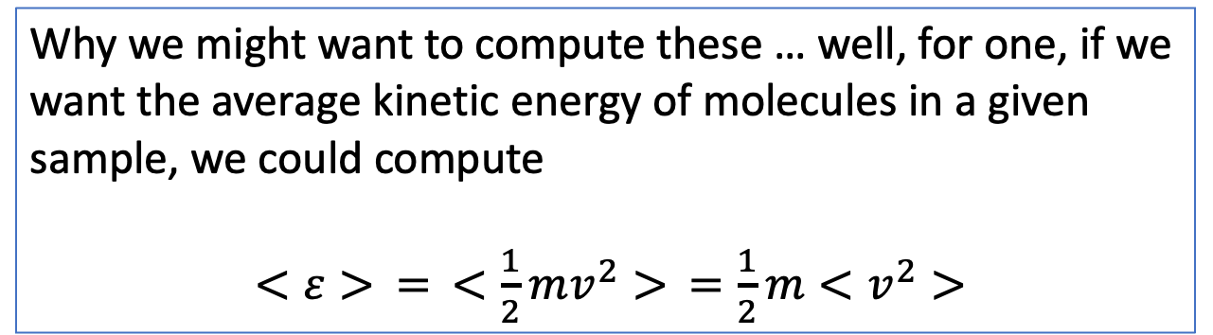
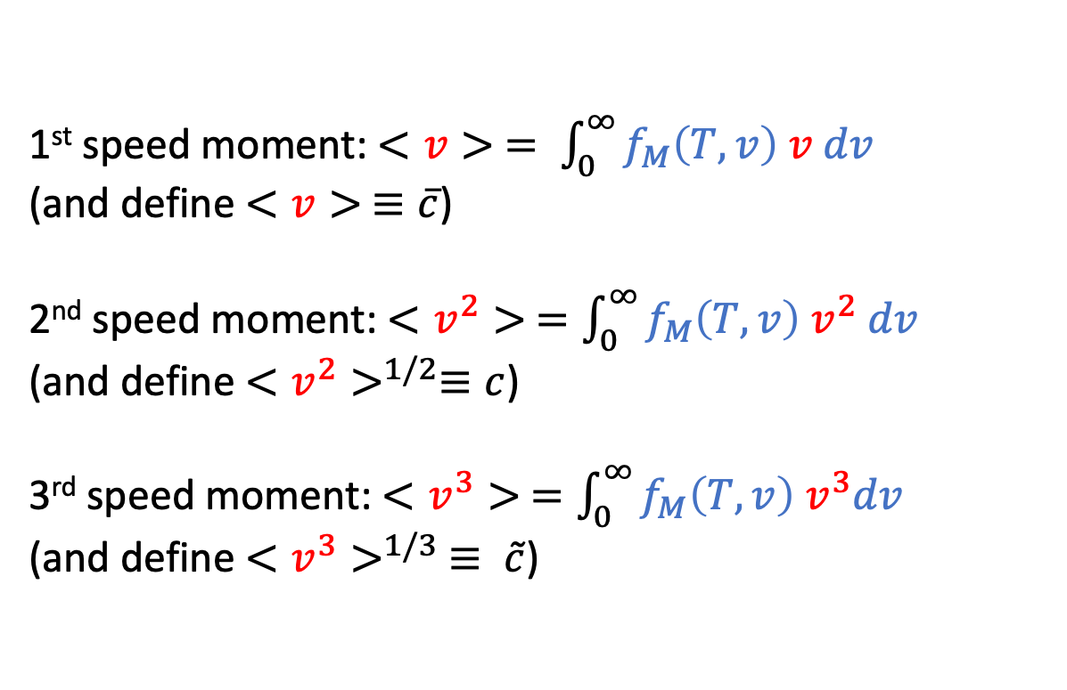
Generalizing the idea of “speed averages” to “speed moments”
1st speed moment: $<v> = \int_{0}^{∞}{f_{M}\left(T,v\right) v dv}$
(and define $<v> ≡\overline{c}$)
2nd speed moment: $<v^{2}> =\int_{0}^{∞}{f_{M}\left(T,v\right) v^{2} dv}$
(and define $<v^{2}>^{1/2}≡c$)
3rd speed moment: $<v^{3}> =\int_{0}^{∞}{f_{M}\left(T,v\right){ v}^{3}dv}$
(and define $<v^{3}>^{1/3}$ $≡ \tilde{c}$)
Why we might want to compute these … well, for one, if we want the average kinetic energy of molecules in a given sample, we could compute
$<ε> = <\frac{1}{2}mv^{2}> =\frac{1}{2}m<v^{2}>$

Slide 7
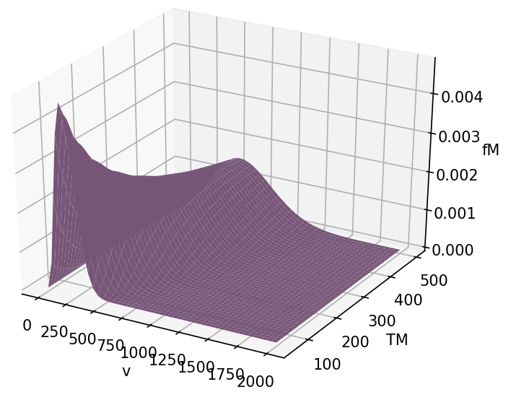
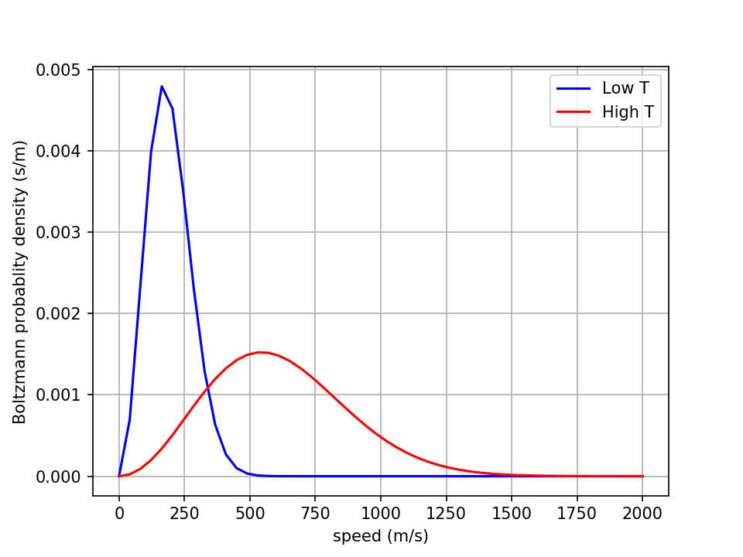

Getting those moments numerically: First you slice an isotherm
fMfirst
vfirst ->

Slide 8
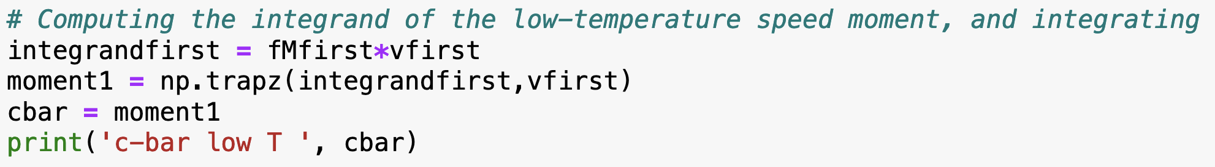
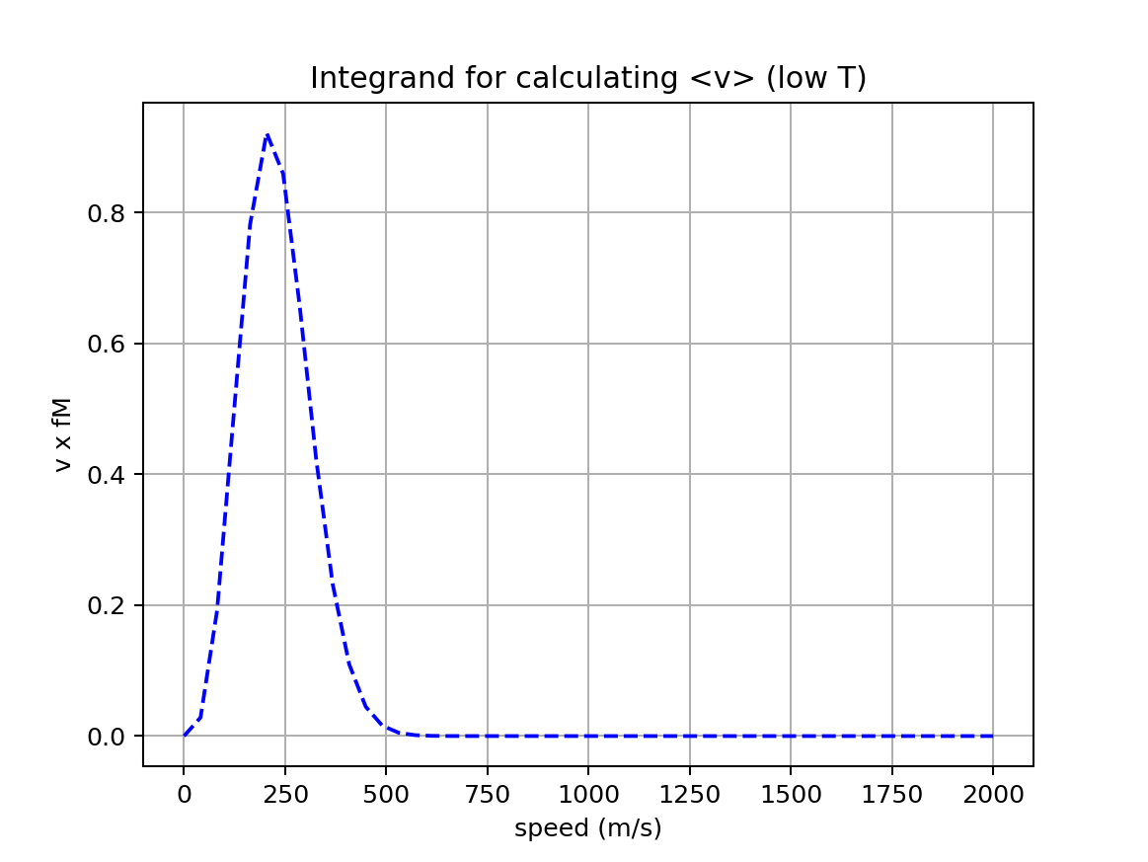
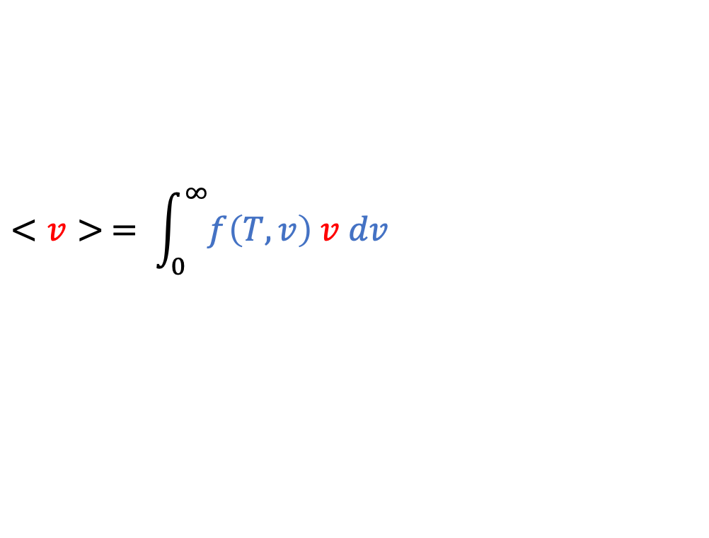
Then you integrate
Mathematically, this is written:
$$<v> = \int_{0}^{∞}{f\left(T,v\right) v dv}$$

Slide 9
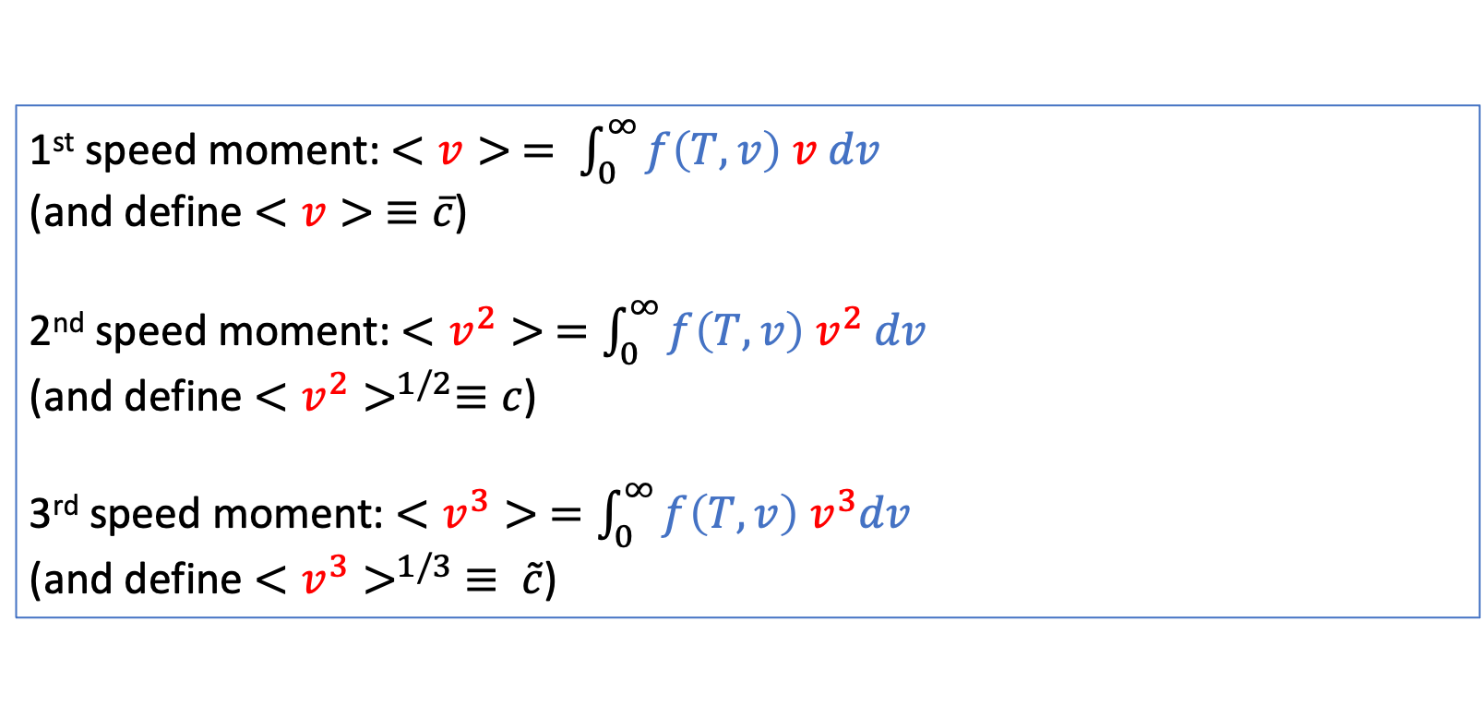
You’ll be getting several moments, actually
1st speed moment: $<v> = \int_{0}^{∞}{f\left(T,v\right) v dv}$
(and define $<v> ≡\overline{c}$)
2nd speed moment: $<v^{2}> =\int_{0}^{∞}{f\left(T,v\right) v^{2} dv}$
(and define $<v^{2}>^{1/2}≡c$)
3rd speed moment: $<v^{3}> =\int_{0}^{∞}{f\left(T,v\right){ v}^{3}dv}$
(and define $<v^{3}>^{1/3}$ $≡ \tilde{c}$)

Slide 10
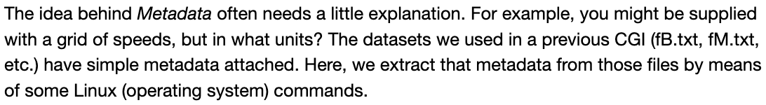
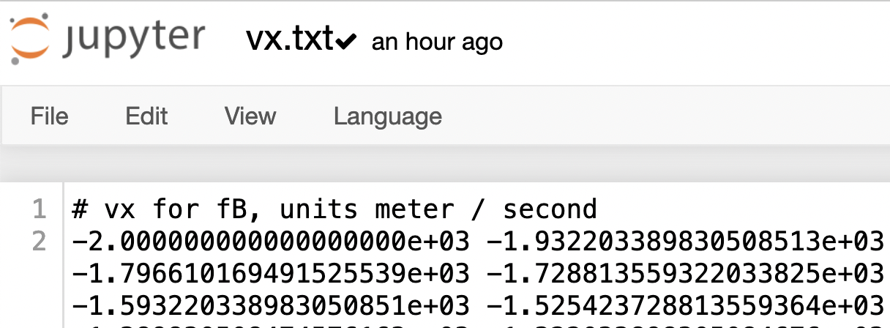
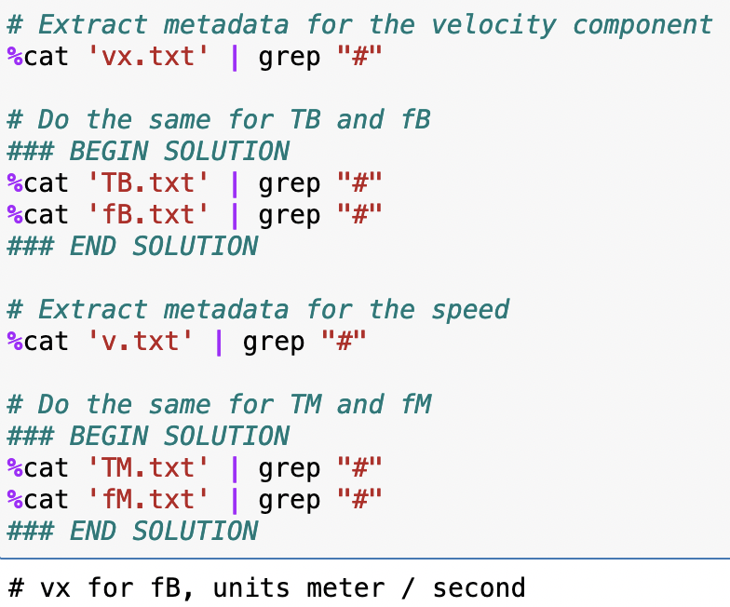
The idea of metadata

Slide 11
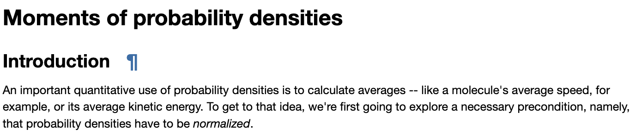

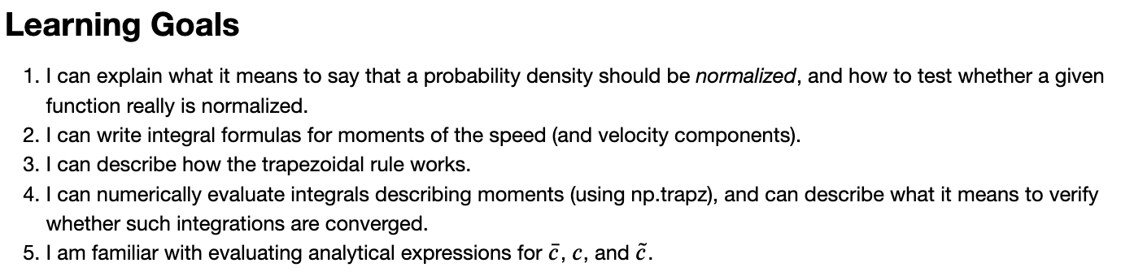
OK, let’s get started

